Slide 1
BINP39
20241121
Research project
Integrative Bioinformatics for Rational AAV Vector
Design
Hooi Min Tan Grahn

Slide 2
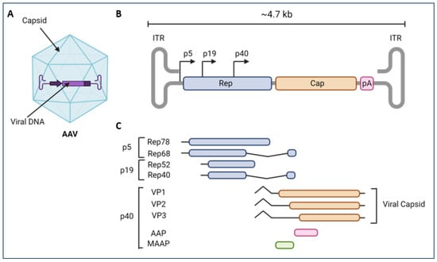
Introduction to AAV in Gene Therapy
Gene therapy, a method for curing genetic diseases by providing healthy copies of defective genes
Benefic of using AAV
Its small genome size and
Its inability to replicate itself in the absence of a helper virus
Therefore, AAV will not replicate exponentially and destroy the cell
Lopez-Gordo et al., Viruses, 2024
Notes:
https://www.mdpi.com/1999-4915/16/3/442
Lopez-Gordo et al., Viruses, 2024
-(A) Adeno-associated virus serotype (AAV) particle with the AAV single-stranded genome, ) is approximately 4.7 kb in length.
-B) AAV2 genome organization including two inverted terminal repeats (ITs) flanking the rep and cap genes, cap polyA, and AAV promoters (p5, p19, and p40).
-(C) Transcriptional map of AAV structural (VP1, VP2, and VP3) and non-structural proteins (Rep78, Rep68, Rep52, Rep40, AAP, and MAAP).
-VP: viral protein; AAP: assembly-activating protein; and MAAP: membrane-associated AAV protein.
-AAV serotypes are classified in a separate genus within the Parvoviridae family, known as Dependovirus,
-because productive infection generally requires either co-infection with a helper virus (such as adenovirus or herpes simplex virus)
-or the induction of cellular stress

Slide 3
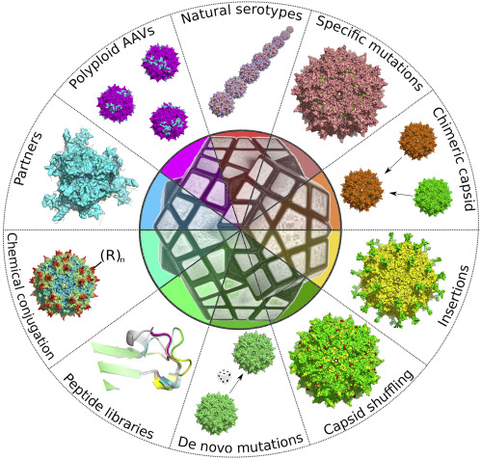
AAV Serotypes and Tissue Targeting
Pupo et al., Mol. Ther. Rev. , 2022
Notes:
https://www.cell.com/molecular-therapy-family/molecular-therapy/fulltext/S1525-0016%2822%2900569-X
-In the context of AAV, serotypes refer to different naturally occurring or engineered variants of AAV that have unique capsid proteins.
-These capsid differences give each serotype specific properties, such as the ability to infect certain types of cells or tissues.
-Chimeric AAV capsids can be engineered by inserting peptides or proteins into specific VP regions to alter AAV serotype tropism.
-This approach focuses on two key decisions: selecting the insert and its insertion site.

Slide 4
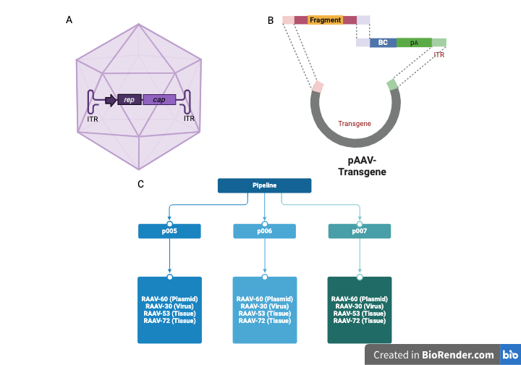
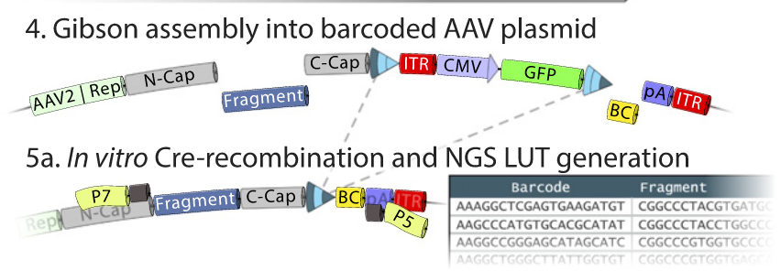
Capsid Engineering and BRAVE
Davidsson et al., PNAS, 2019
Notes:
-The pool of oligonucleotides was assembled into an AAV production backbone with cis-acting AAV2 Rep/Cap and ITR-flanking CMV-GFP.
-A 24-bp random molecular barcode (BC) was simultaneously inserted into the 3′ UTR of the GFP gene.
-Using a fraction of the plasmid preparation, exposed to Cre-recombinase in vitro, a look-up table was generated linking the BC to the peptide.

Slide 5
Bioinformatics Workflow for Plasmid Libraries
The AAV genome
The BRAVE rational design positions a 21-nucleotide fragment and barcode (BC) close together post-plasmid preparation.
Workflow structure and data resources
Notes:
Libraries p005 and p007 were designed using rational design principles, whereas p006 was engineered by incorporating degenerate NNK codons to introduce amino acid randomization

Slide 6
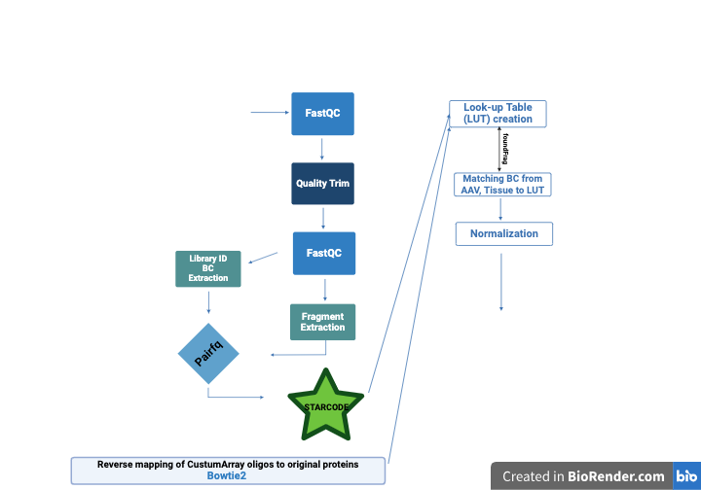
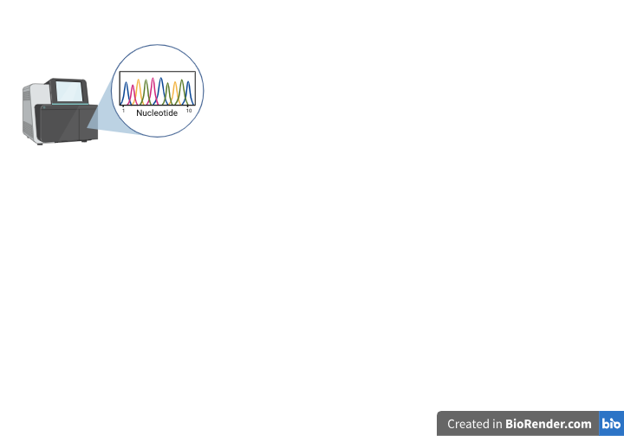
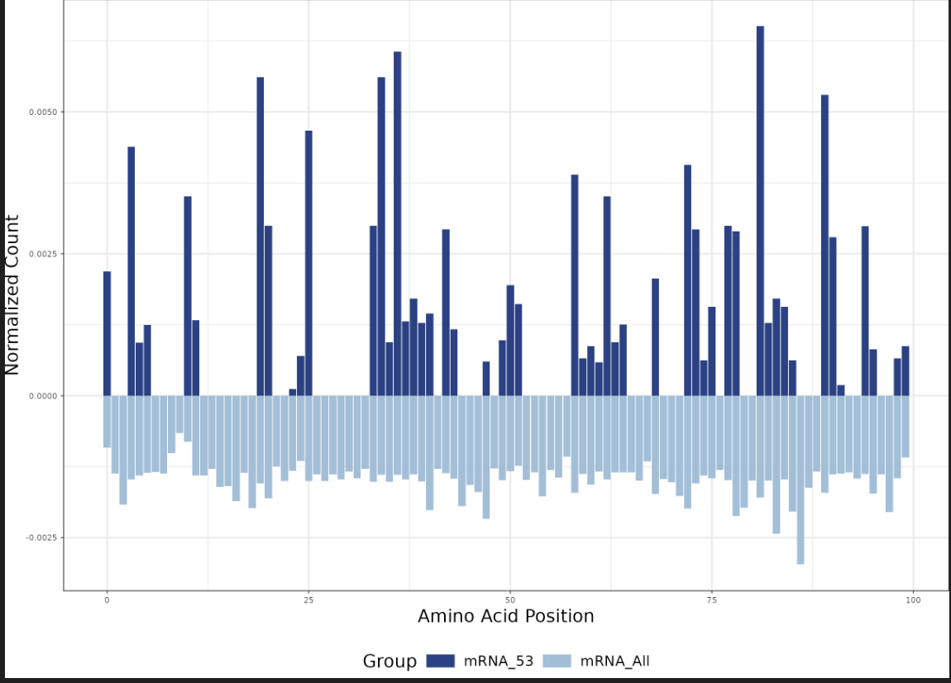
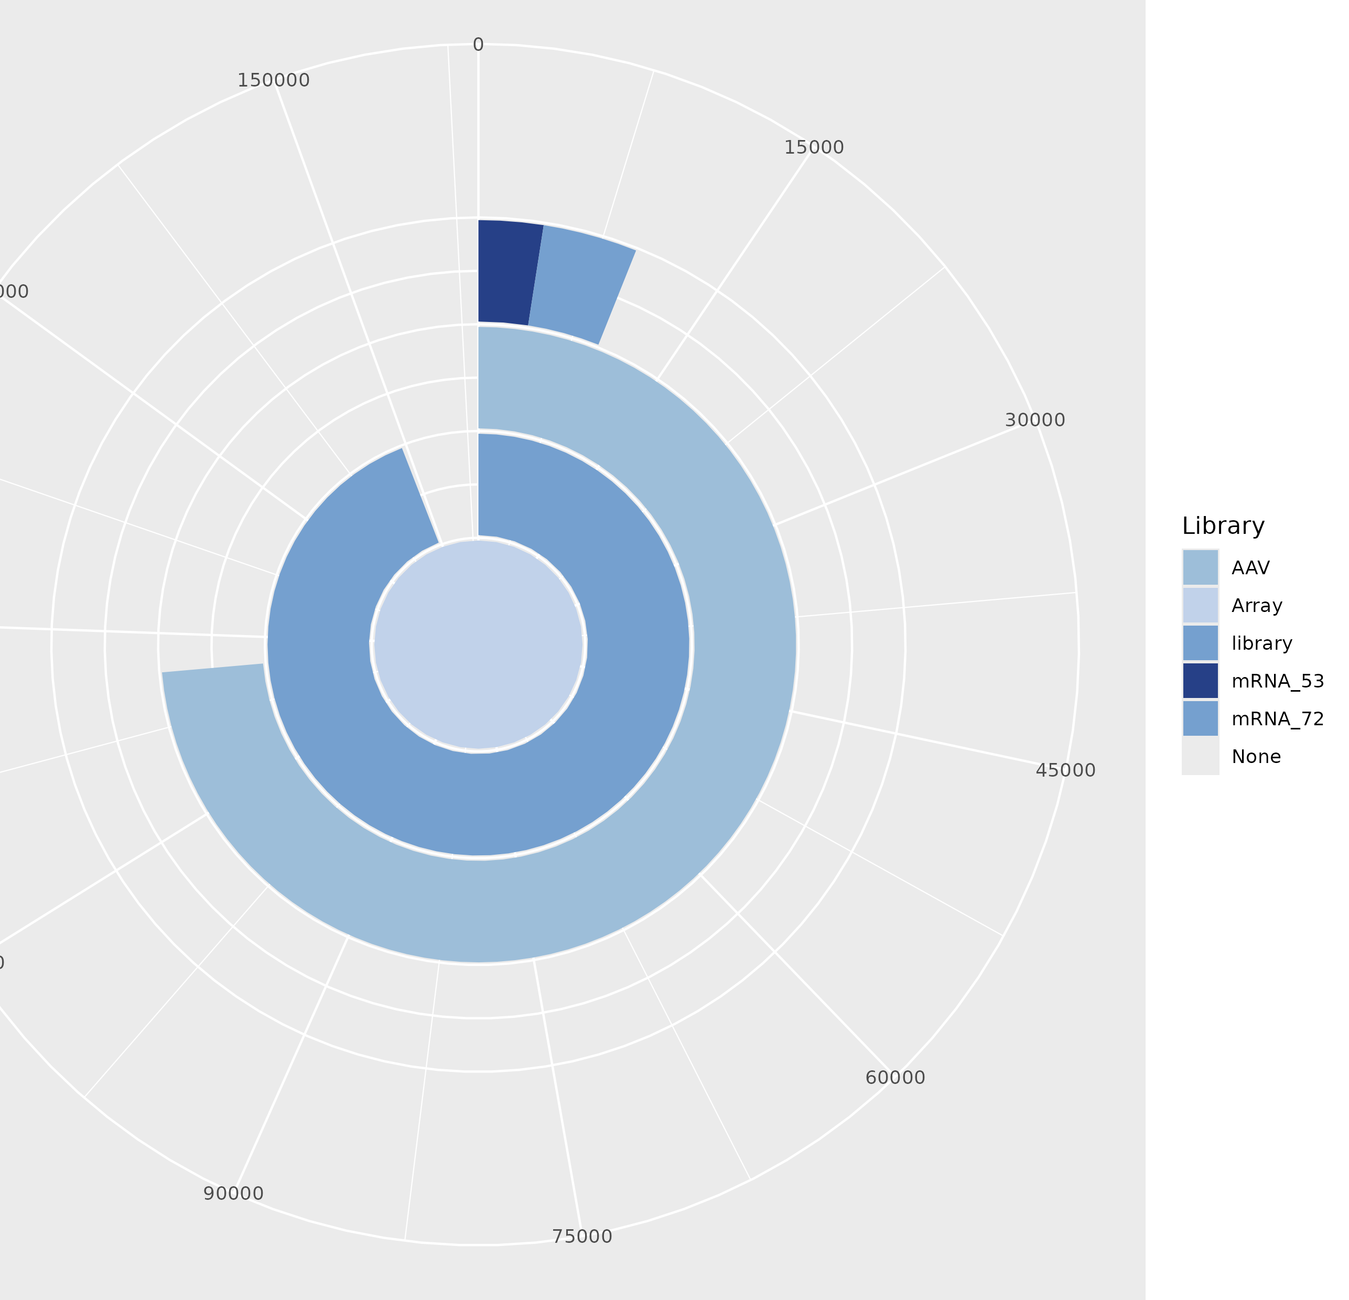
Comprehensive Bioinformatics Tools and Data Analysis Workflow
Notes:
-An overview of the data processing pipeline, including FastQC analysis of fastq reads before and after quality trimming; extraction of library IDs, barcodes (BC), and fragments;
-pairing BC with fragments using pairfq; BC reduction via Starcode; mapping custom array oligos back to the original proteins using Bowtie2;
-creation of a Look-Up Table for identifying fragments derived from the viral library and infected tissue samples (foundFrag);
-normalization of all reads using various computational methods; and subsequent data analysis to generate outputs like circular bar plots, pairwise plots, and motif creation.

Slide 7
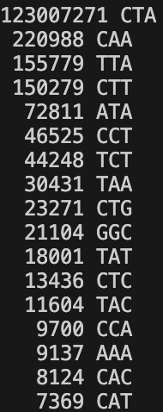
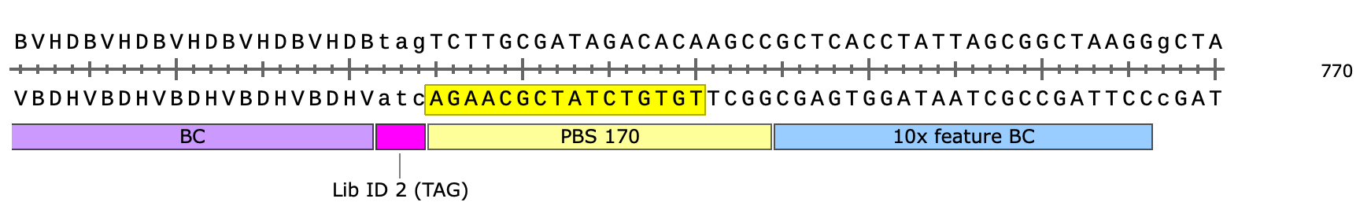
RAAV-60: p007
Table of fragment, Barcode and Library of p007 (same sequece as given template)
Fragment_ID Fragment_Seq Barcode_ID Barcode_Seq Library_ID Library_Seq
@VH00947:47:AACWJKFM5:1:1101:60988:1454 2:N:0:AGGCAGAA+AGAGGATA ACCAGCCTGCCCCCCCGGCCC @VH00947:47:AACWJKFM5:1:1101:60988:1454 1:N:0:AGGCAGAA+AGAGGATA CTAGGCTCAATTACTCGAATACTC @VH00947:47:AACWJKFM5:1:1101:60988:1454 1:N:0:AGGCAGAA+AGAGGATA CTA
Total count of sequences: 123875291
Notes:
tail -n +2 7_fragment_barcode_library.txt | wc -l 123875291
-For plasmid library p007, 123,875,291 reads were processed
-Each plasmid library was associated with specific library IDs: p007 used (CTA)

Slide 8
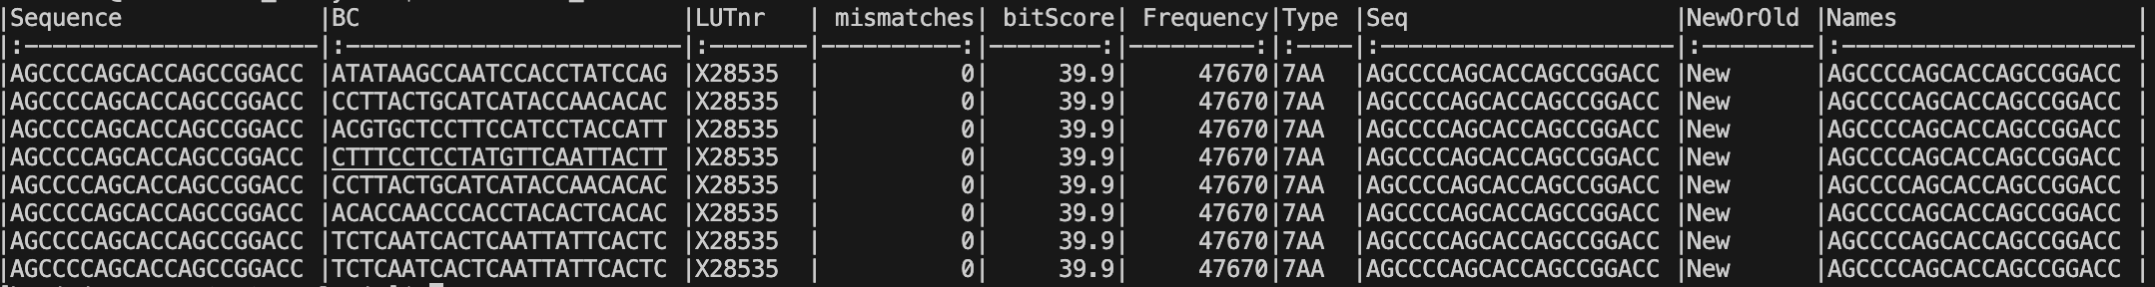
RAAV-60: p007 fragment and barcode table
Alignment percentage: 98%
Notes:
-For plasmid library p007, 98% of the sequences were aligned with the original sequences established in the lab
-priminary look-up table: initial reference dataset that links key identifiers or variables, enabling efficient mapping and retrieval of information.
-connect sequence barcodes to corresponding peptides

Slide 9
p006 Circular barplot
AAV
Lib
Unique peptides
Total library = 340,909
Intercept AAV, library = 18,517
Intercept mRNA_53, AAV = 395
Intercept mRNA_72, AAV = 42
Notes:
-The circular bar plot displays the absolute quantities of unique peptides recovered at each stage of the BRAVE assay.
-The p006 library contained 340,909 unique peptides, with 18,517 from the virus library, 395 from tissue-infected samples (RAAV-53),
-and 42 from another tissue-infected sample (RAAV-72)

Slide 10
p007 Circular barplot
Unique peptides
Total array = 158788
Intercept library, array = 117148
Array
Intercept AAV, library = 116881
Lib
m_53
AAV
Intercept mRNA_53, AAV = 53294
m_72
Intercept mRNA_72, AAV = 85392
Notes:
-The array contained 158,788 entries, created in the lab. Within the p007 library, 117,148 unique peptides were identified.
-The virus library contained 116,881 unique peptides, with 53,294 detected in infected tissue (RAAV-53) and 85,392 in infected tissue (RAAV-72)

Slide 11
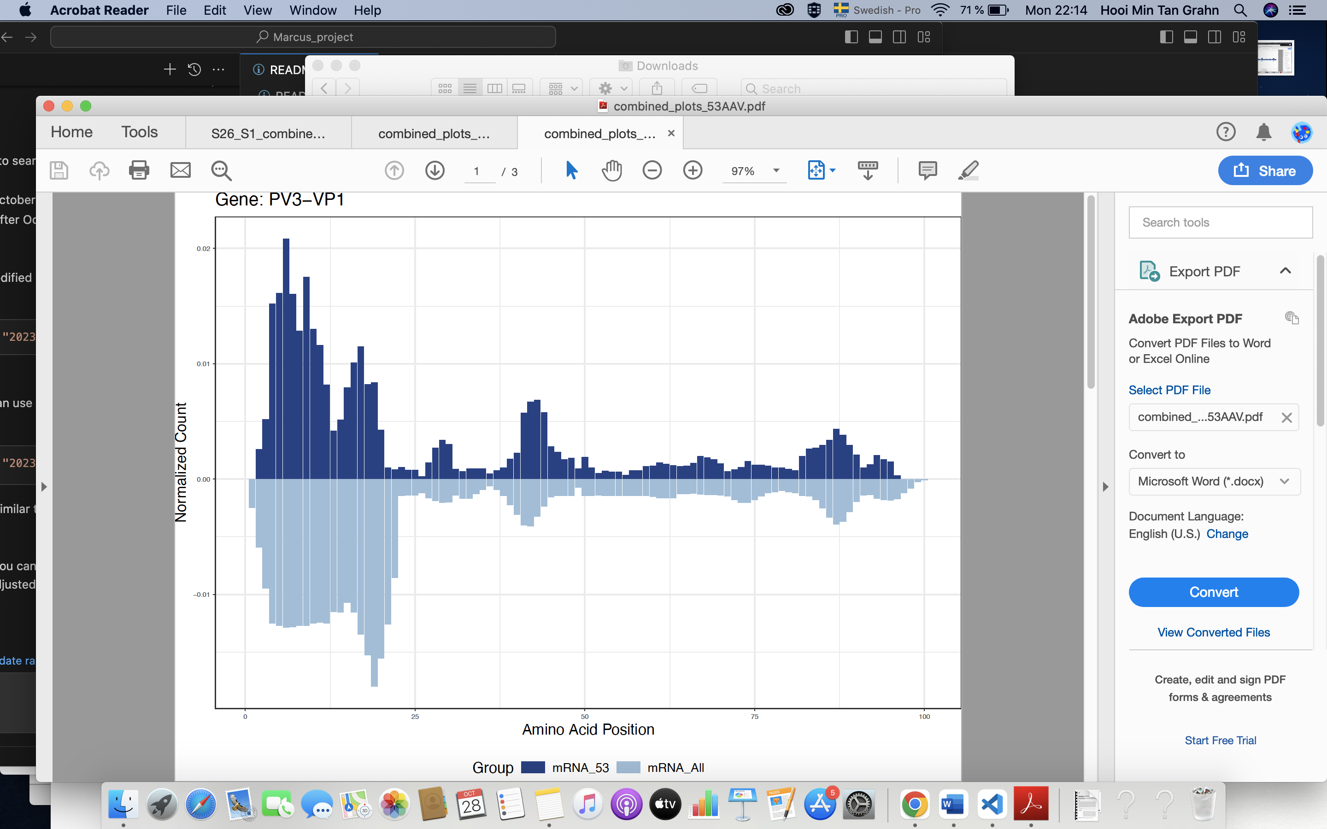
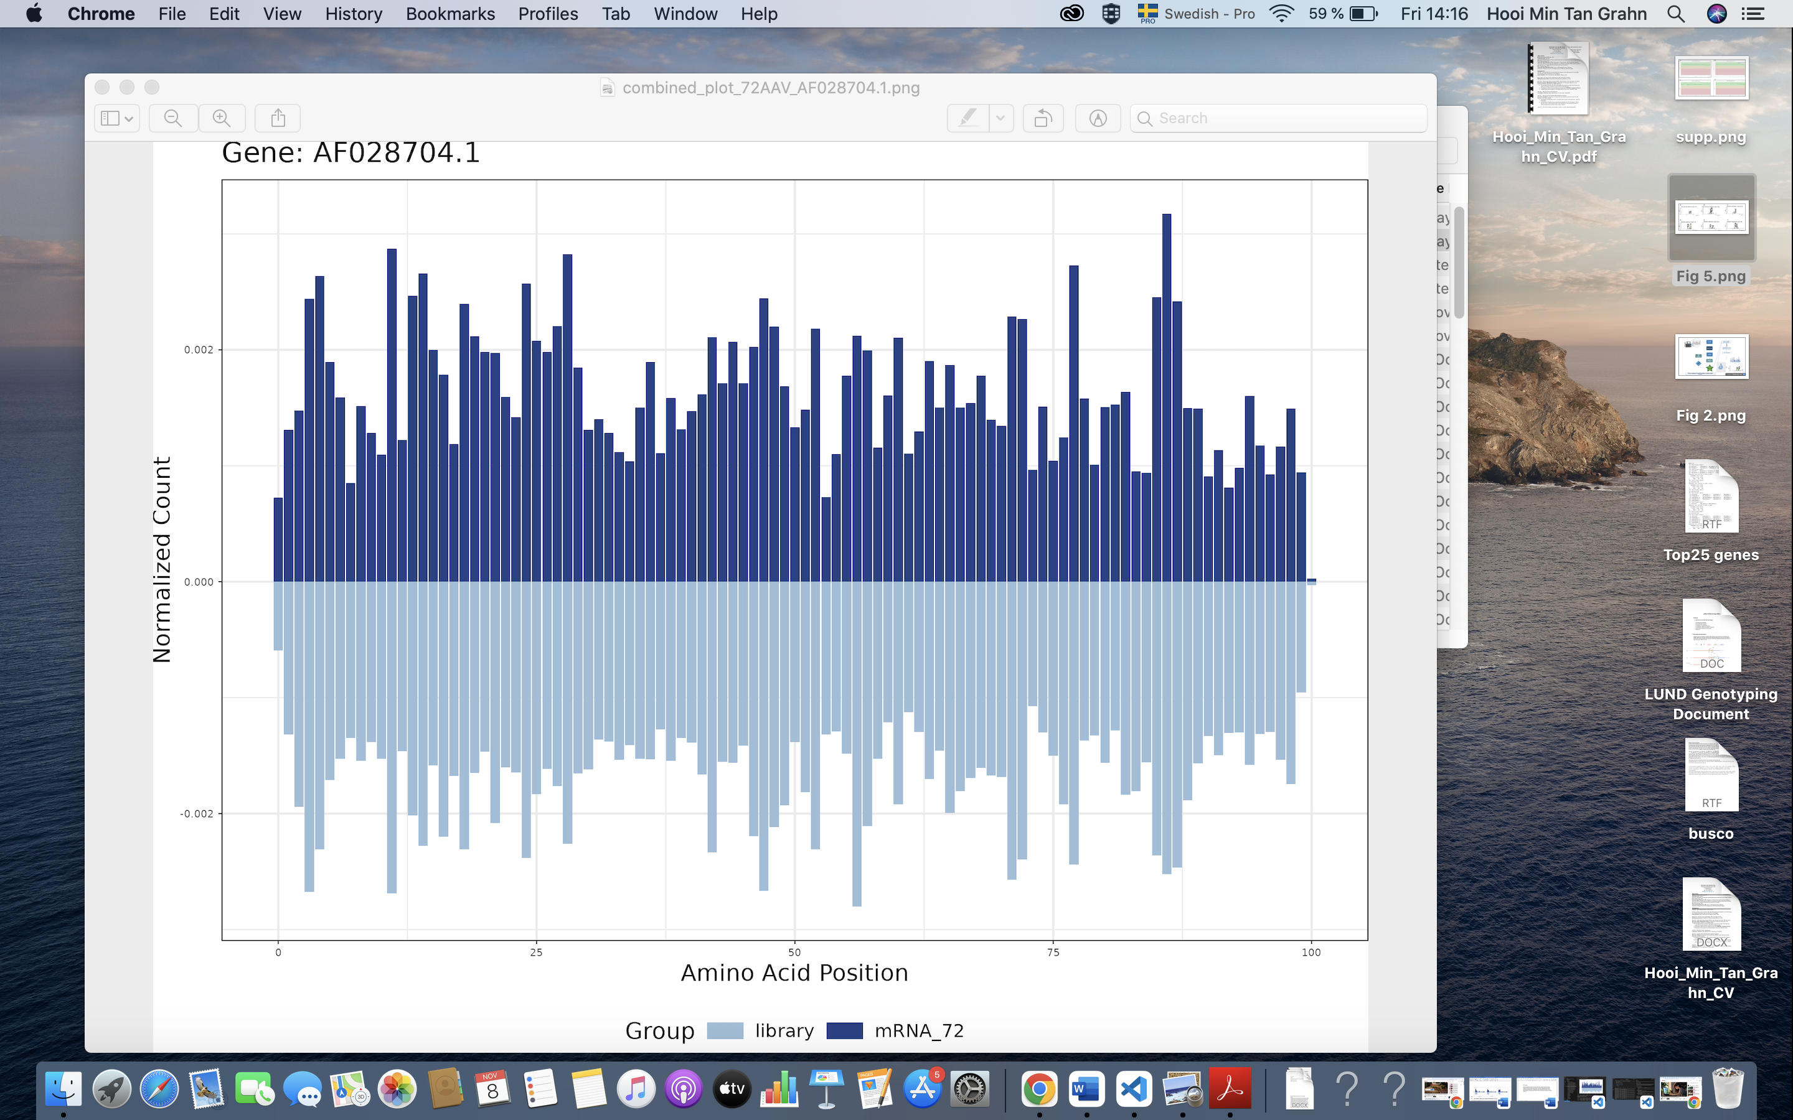
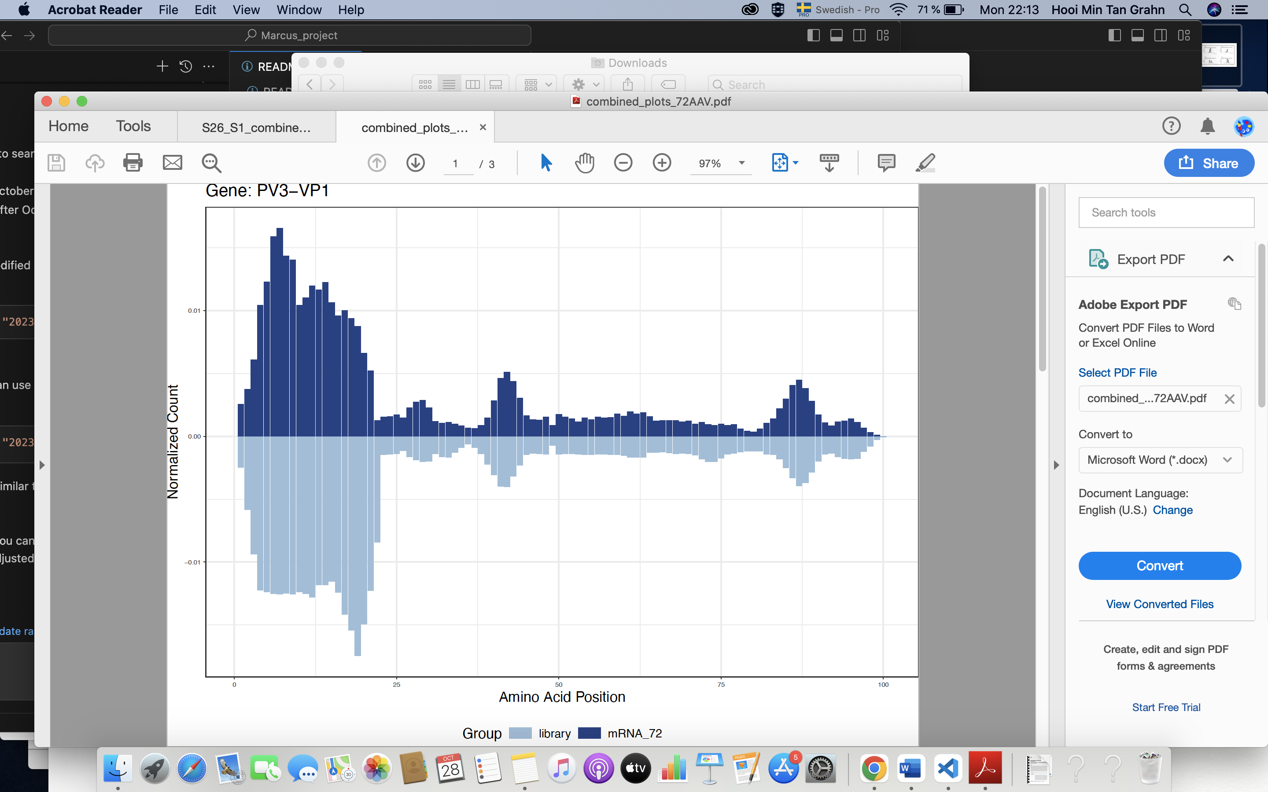
Pairwise plot
A
Peptide A
C
Peptide B
B
Peptide A
Notes:
-Relative Amino Acid Frequency Distribution. The height of each bar reflects the relative frequency of a specific amino acid, adjusted according to the total library,
-and aggregated from all peptides spanning that region.
-Peptides from the highest peak (Fig. 4A, 4B) were hypothesized to demonstrate efficient retrograde transport and local infectivity in the rat brain,
-marking them as prime candidates for further testing.
-In vivo screening identified the top 25 peptides from proteins linked to multiple barcodes and consistently detected across samples (Fig. 4).

Slide 12
Top 25 peptide p007, by sum of BC count
A
B
C
Gene A
Gene B
Gene C
D
E
F
Gene D
Gene D
Gene D
Notes:
-Bitmap plots of consensus motifs generated using the Hammock clustering approach, which utilizes a hidden Markov model (HMM) to align and identify recurring patterns across sequences.
-(A-C) Consensus motifs of distinct peptides derived from different proteins. (D-F) Consensus motifs of three distinct peptides from the same protein.
-The Hammock approach used a hidden Markov model (HMM) to identify sequence patterns and group peptides based on sequence homology.
-The y-axis, measured in bits, reflected information content at each motif position, with higher values indicating conserved residues and lower values indicating variability.
-This analysis revealed conservation patterns and highlighted key residues critical for function or recognition.

Slide 13
Data Processing and Normalization Challenges
Memory Challenges:
The lookup table (LUT) for p005 and p007 libraries required high memory, limiting the ability to process the entire dataset simultaneously.
Chunking for Scalability:
Data was divided into manageable chunks based on metadata, enhancing scalability and performance.
Dynamic chunking allowed processing of varying data sizes effectively.
Programming and Parallel Processing:
Used R packages ‘future.apply’ and ‘plan’ for parallel processing.
Setting workers to 8 in parallel processing succeeded, while 32 caused out-of-memory errors due to RAM limitations.
Normalization Strategies:
Two methods were used:
Chunk-by-Chunk Normalization: Processed data in smaller chunks iteratively.
Saving Intermediate Files: Stored intermediate .rds files and filtered low-count entries before normalization.
Error Handling in Clustering:
Adjusted Hammock parameter (--greedy_threshold = 15) to resolve StringIndexOutOfBoundsException.
This threshold controlled sequence similarity, balancing strictness and variation within clusters.
Outcome:
Despite technical challenges, BRAVE successfully linked peptide fragments to unique barcodes in targeted tissues, advancing gene therapy research.

Slide 14

Conclusion & Future Direction
Promise of AAV Gene Therapy:
AAV vector-based therapies are emerging as a powerful tool for treating neurological diseases, especially for challenging CNS targets.
Clinical Potential:
Current trials are exploring AAV vectors for delivering therapeutic proteins to the CNS, benefiting from the long-term expression in non-dividing cells like neurons.
Key to Success – Effective Delivery:
Capsid selection is crucial, as it influences tissue and cell specificity.
Different CNS applications may require unique administration routes to ensure target distribution and minimize off-target effects.
Future Outlook:
Advances in capsid optimization, delivery techniques, and transgene design are broadening AAV therapy's potential for CNS diseases, paving the way for new treatments and expanded applications.

Slide 15
Acknowledgments
Marcus Davidsson, COO, rAAVen
Patrick Aldrin-Kirk, CSO, rAAVen

Slide 16
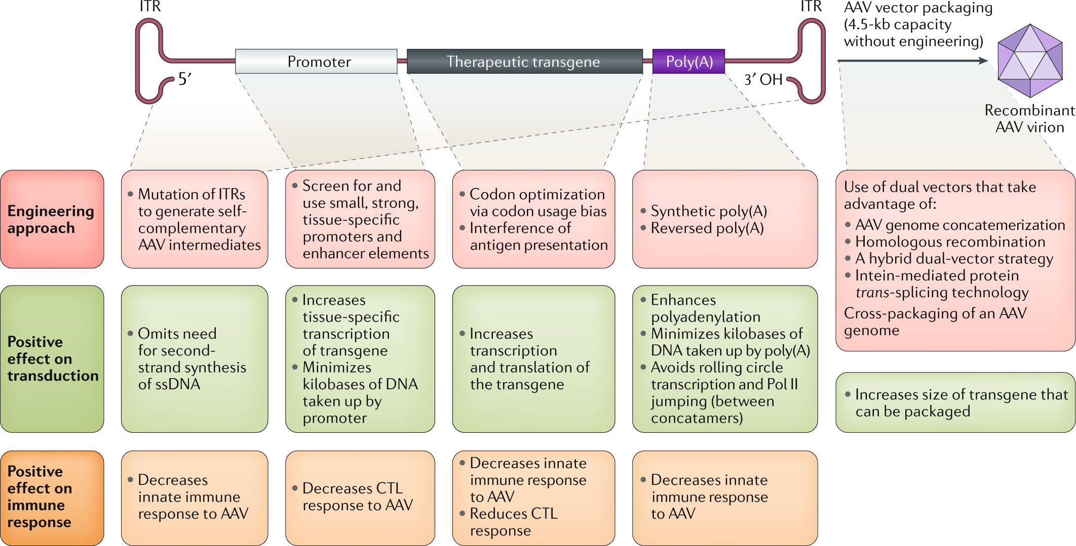
Engineering the AAV cassette
Limitations of rAAV and Advancements with scAAV
Chengwen Li & R. Jude Samulski, Nat.Rev. Genetics, 2020
Notes:
https://www.nature.com/articles/s41576-019-0205-4
-rAAV vectors require host cells to synthesize double-stranded DNA. Self-complementary rAAV (scAAV) vectors bypass this
by packaging DNA dimers, which form double-stranded DNA directly upon uncoating (During virus entry, capsid shells are
primed and disassembled in a complex, tightly-regulated, multi-step process termed uncoating).
-Mutation of one inverted terminal repeat (ITR) on the AAV vector, which prevents the nicking of Rep protein,
can generate self-complementary AAV vector to enhance vector transduction.

Slide 17
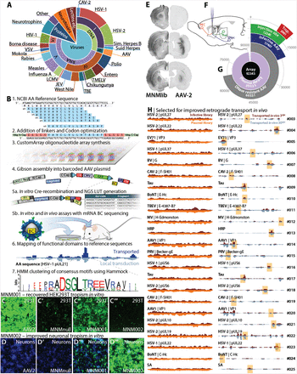
Barcode Clustering in Gene Therapy Research
Davidsson et al., PNAS, 2019
Notes:
https://www.biorxiv.org/content/10.1101/335372v1.full
-The BRAVE approach leverages a library of AAV capsids engineered with peptides derived from synapse-targeting proteins to assess retrograde transport efficacy.
-This involves computational peptide generation, incorporation of molecular barcodes, and AAV library synthesis for in vitro and in vivo screening.
-Through iterative testing and sequencing, BRAVE identifies capsid variants with enhanced transport and infectivity, notably improving AAV tropism for specific brain regions and neuronal populations.
-high retrograde transport efficacy means that a viral vector (like AAV) can effectively deliver genetic material to neurons across connected brain regions
-AAV (adeno-associated virus) capsid, in moving "backwards" along neurons from the axon terminals toward the cell body, and potentially further up the chain to connected neurons.

Slide 18
RAAV-60: p007
Utilized reads: 123875291
Original unique barcodes: 6747020
SC reduced unique barcodes: 3333752
Total number of single-read Barcodes: 2685026 (BC appears only once)
Clean multi-read barcodes: 14545 (BC appears only once from multi)
Chimeric multi-read barcodes: 634181 (BC appears > 1 from multi)
Number of barcodes with false mCount: 0
Notes:
Total number of definitive Barcodes: 72745553
Total number of ambiguous Barcodes: 0
RetainedBC <- length(unique(full.table$oldBC))
scBC <- length(unique(full.table$BC))
print(paste("Original unique barcodes:", RetainedBC))
print(paste("SC reduced unique barcodes:", scBC))
print("Utilized reads.......")
print(nrow(full.table))
print("Clean multi-read barcodes.......")
print(nrow(temp.table.multi.clean))
print("Chimeric multi-read barcodes.......")
print(length(unique(temp.table.multi$BC)))
print(paste("Number of barcodes with false mCount:", nrow(temp.table.multi[mCount > tCount])))
print(paste("Total number of definitive Barcodes:", length(grep("Def", temp.table.multi.consensus$Mode))))
print(paste("Total number of ambiguous Barcodes:", length(grep("Amb", temp.table.multi.consensus$Mode))))
print(paste("Total number of single-read Barcodes:", nrow(temp.table.single)))
print(paste("Number of barcodes with false mCount:", nrow(temp.table.multi[mCount > tCount])))

Slide 19
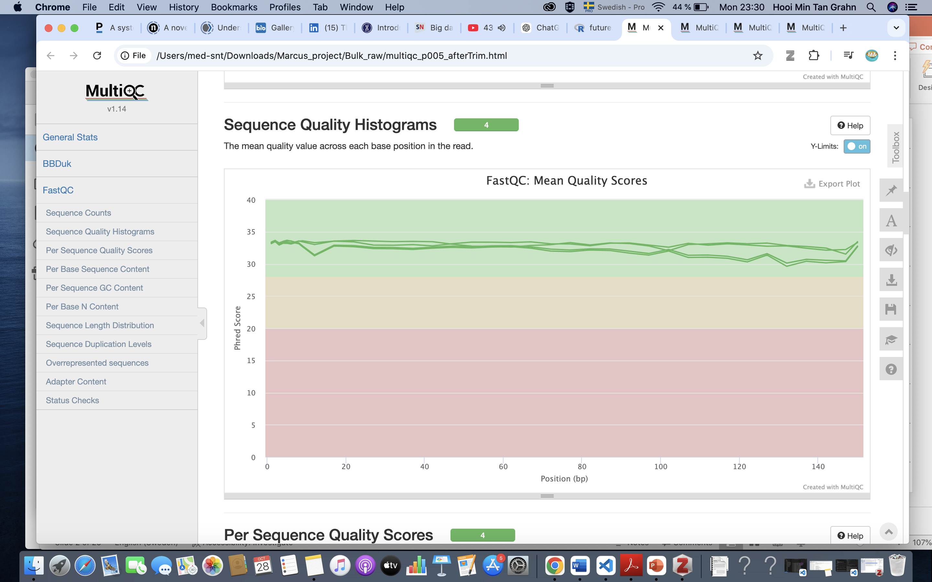
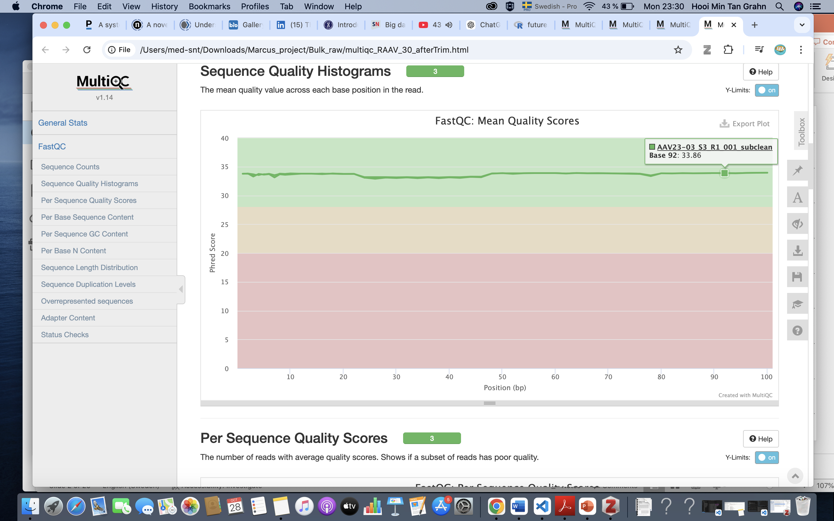
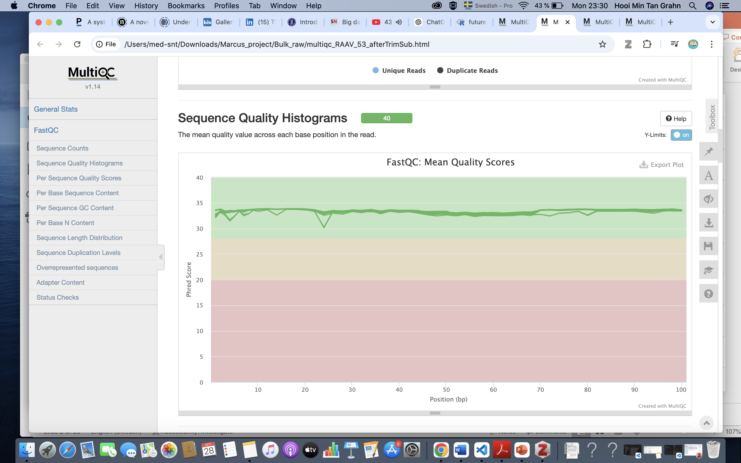

Multiqc after trim A. RAAV-60, B. RAAV-30, C. RAAV-53, D. RAAV-72
A
B
C
D
Notes:
-MultiQC is run after trimming to consolidate and visualize QC reports from multiple samples, enabling quick assessment of trimming success.
-By compiling post-trim metrics (e.g., read quality, read length, adapter content) from tools like FastQC,
-MultiQC provides a comprehensive summary that indicates data readiness for downstream analysis.

Slide 20
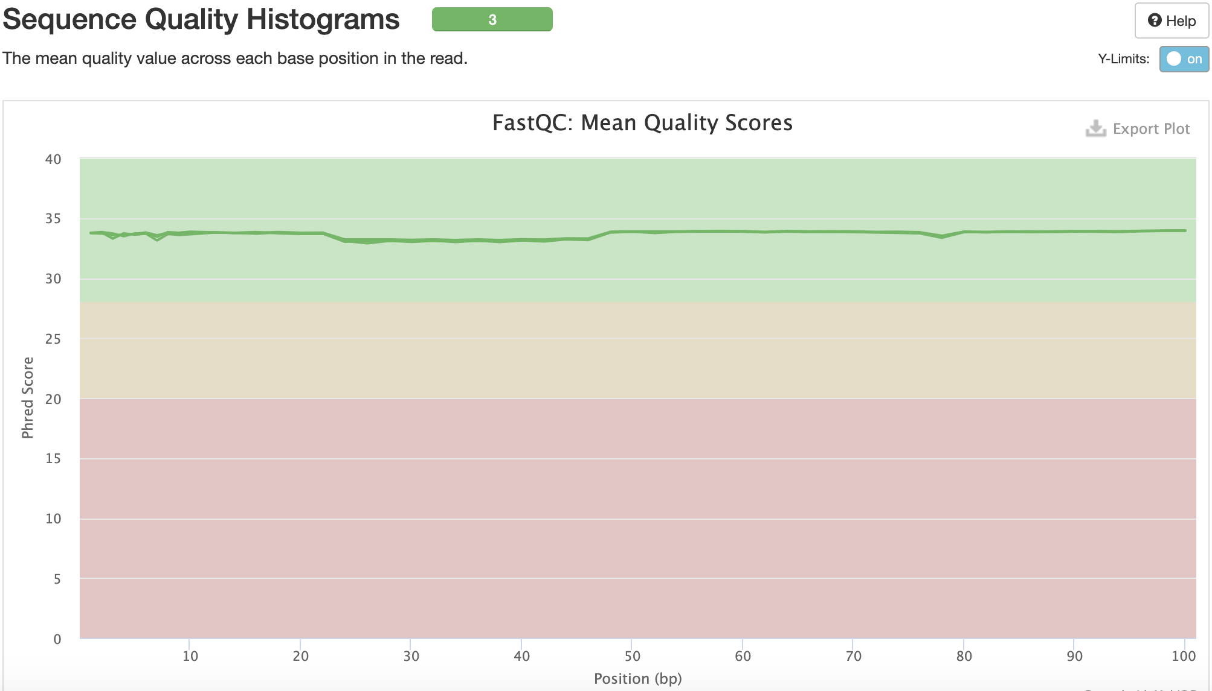
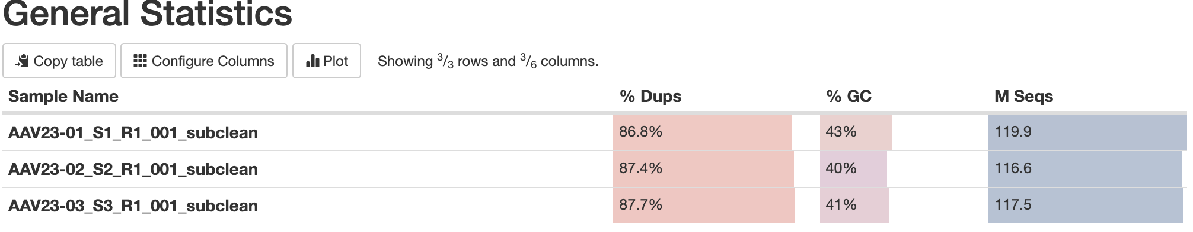
RAAV-30 AAV virus library

Slide 21
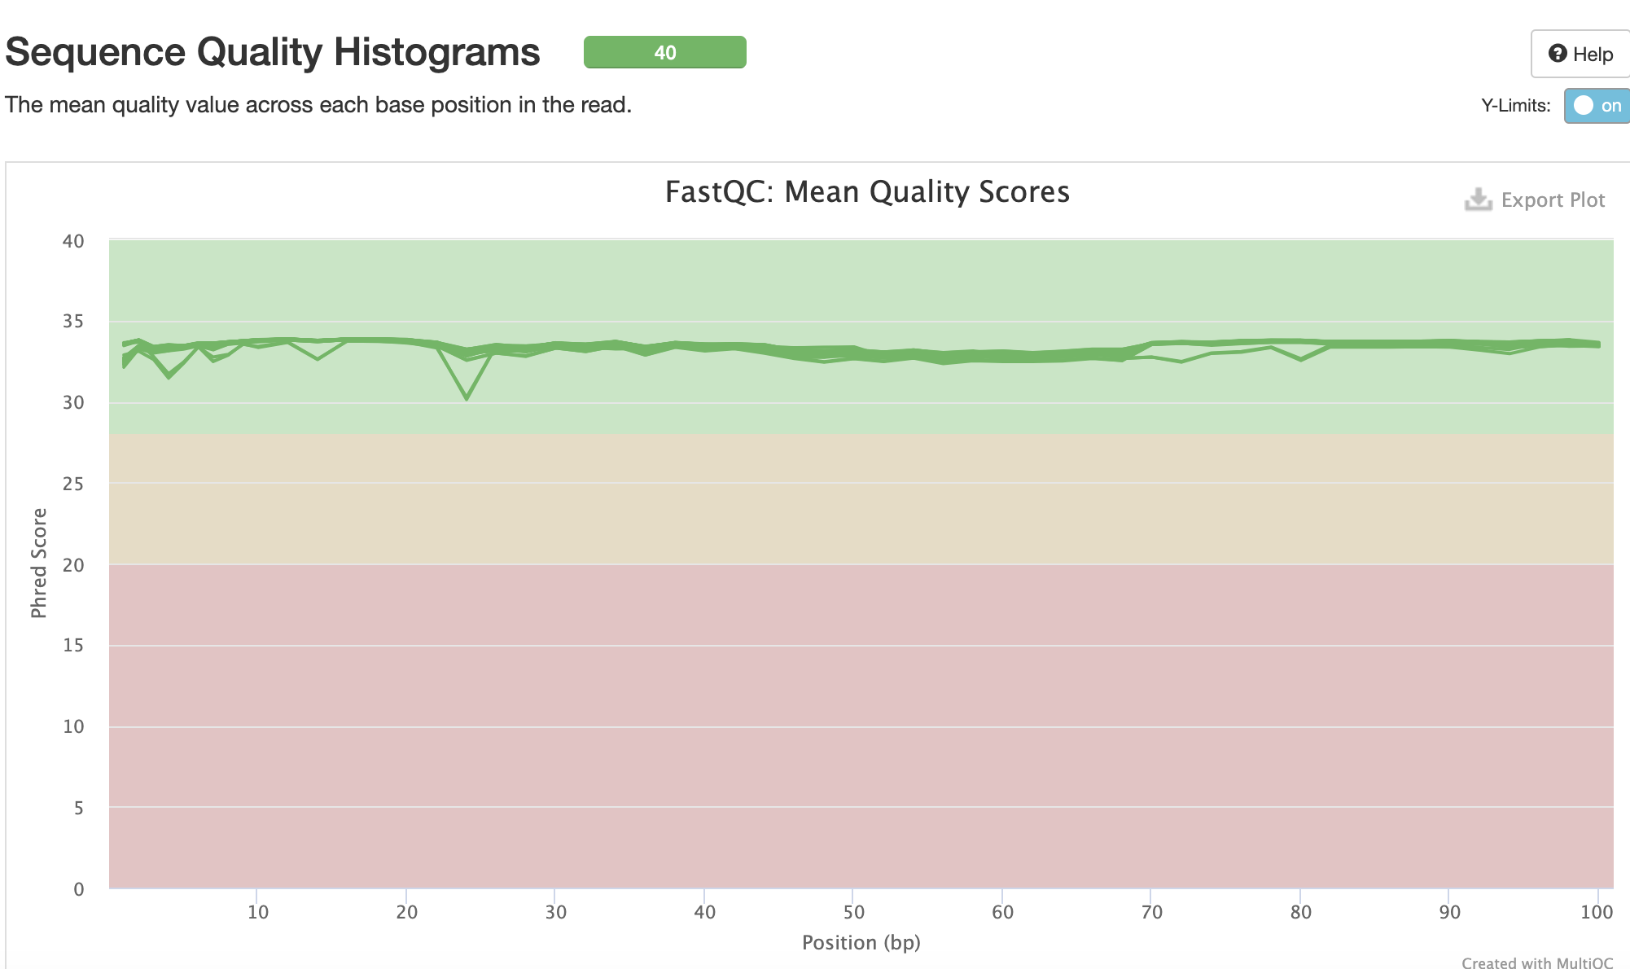
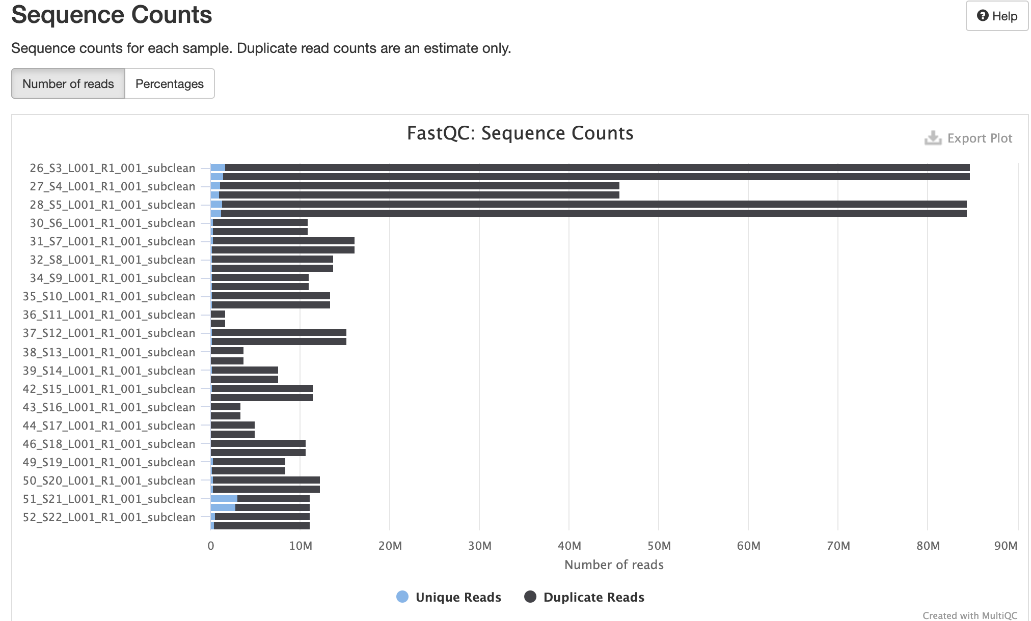
RAAV-53 tissues

Slide 22
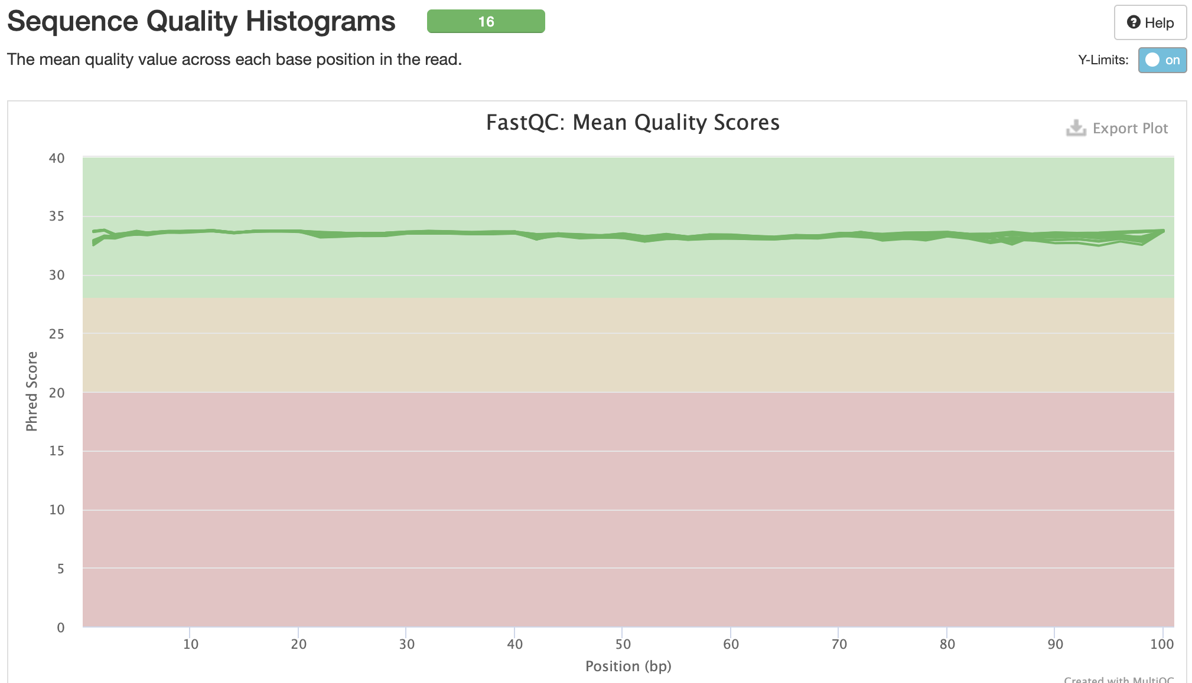
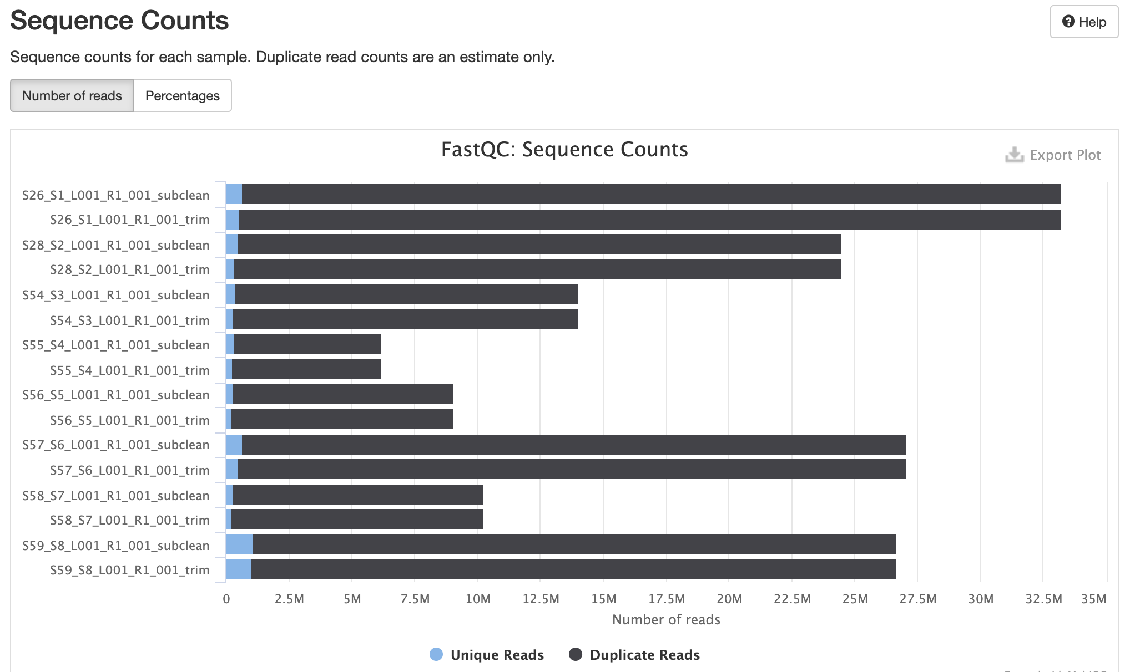
RAAV-72 tissues

Slide 23
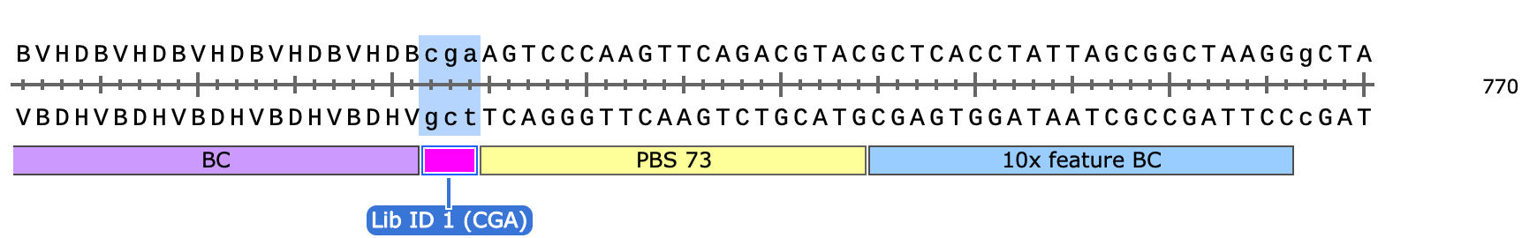
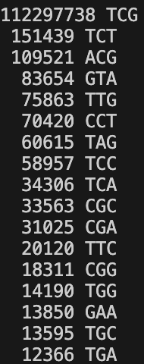
RAAV-60: p005 fragment
Table of fragment, Barcode and Library of p005
Fragment_ID Fragment_Seq Barcode_ID Barcode_Seq Library_ID Library_Seq
@VH00947:47:AACWJKFM5:1:1101:36864:1341 2:N:0:CGTACTAG+ATAGAGAG CCCTTCGACGCCAGCCTGCTG @VH00947:47:AACWJKFM5:1:1101:36864:1341 1:N:0:CGTACTAG+ATAGAGAG ACTTGAATACTTATTCCTTCCCTT @VH00947:47:AACWJKFM5:1:1101:36864:1341 1:N:0:CGTACTAG+ATAGAGAG TCG
Total count of sequences: 113150190
Notes:
tail -n +2 5_fragment_barcode_library.txt | wc –l 113150190
## LUT frag-bar-lib ## --apply for p005, p006, p007
mkdir 01_LUT
sbatch /home/hooimin/lu2024-17-19/RAAV-60/scripts/LUT_final.sh
5_fragment_barcode_library.txt
### Sort unique library (after paired) ### --apply to all p005,p006, p007
#### please mkdir 02_sortUniq before, otherwise it will fail ####
sbatch /home/hooimin/lu2024-17-19/RAAV-60/scripts/sort_uniqueLib.sh

Slide 24
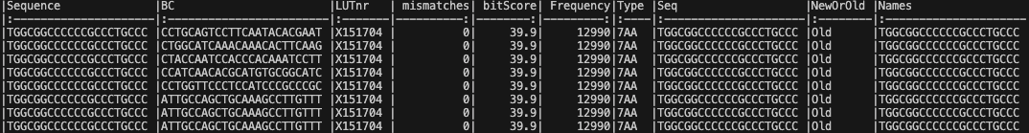
RAAV-60: p005 sorted fragment aligned to fragment final
Alignment percentage: 98%

Slide 25
RAAV-60: p005
Utilized reads: 113150190
Original unique barcodes: 9202839
SC reduced unique barcodes: 5434737
Single-read Barcodes: 2191113 (BC appears only once)
Clean multi-read barcodes: 38162 (BC appears only once from multi)
Chimeric multi-read barcodes: 3205462 (BC appears > 1 from multi)
Number of barcodes with false mCount: 0
Notes:
Total number of definitive Barcodes: 130903718
Total number of ambiguous Barcodes: 0
RetainedBC <- length(unique(full.table$oldBC))
scBC <- length(unique(full.table$BC))
print(paste("Original unique barcodes:", RetainedBC))
print(paste("SC reduced unique barcodes:", scBC))
print("Utilized reads.......")
print(nrow(full.table))
print("Clean multi-read barcodes.......")
print(nrow(temp.table.multi.clean))
print("Chimeric multi-read barcodes.......")
print(length(unique(temp.table.multi$BC)))
print(paste("Number of barcodes with false mCount:", nrow(temp.table.multi[mCount > tCount])))
print(paste("Total number of definitive Barcodes:", length(grep("Def", temp.table.multi.consensus$Mode))))
print(paste("Total number of ambiguous Barcodes:", length(grep("Amb", temp.table.multi.consensus$Mode))))
print(paste("Total number of single-read Barcodes:", nrow(temp.table.single)))
print(paste("Number of barcodes with false mCount:", nrow(temp.table.multi[mCount > tCount])))

Slide 26
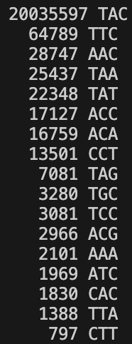
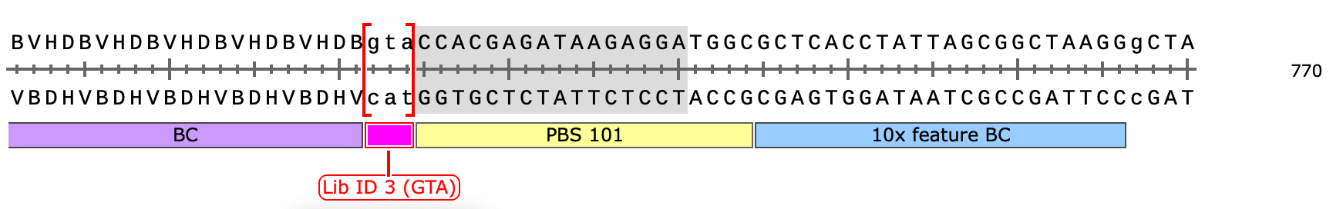
RAAV-60: p006 fragment
Table of fragment, Barcode and Library of p006 (same sequece as given template)
Fragment_ID Fragment_Seq Barcode_ID Barcode_Seq Library_ID Library_Seq
@VH00947:47:AACWJKFM5:1:1101:22757:2609 2:N:0:TAAGGCGA+ATAGAGAG AATTCGCCTAATCCTTAGTAG @VH00947:47:AACWJKFM5:1:1101:22757:2609 1:N:0:TAAGGCGA+ATAGAGAG AAGTATAGACATACACCCATAAAT @VH00947:47:AACWJKFM5:1:1101:22757:2609 1:N:0:TAAGGCGA+ATAGAGAG TAC
Total count of sequences: 20251305
Notes:
tail -n +2 6_fragment_barcode_library.txt | wc -l 20251305

Slide 27
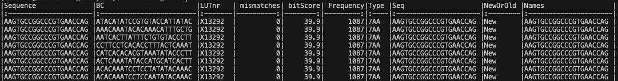
RAAV-60: p006 sorted fragment aligned to fragment final (randomized designed)
Alignment percentage: 27%

Slide 28
RAAV-60: p006
Utilized reads: 20251305
Original unique barcodes: 1261887
SC reduced unique barcodes: 592798
Total number of single-read Barcodes: 306521 (BC appears only once)
Clean multi-read barcodes: 5813 (BC appears only once from multi)
Chimeric multi-read barcodes: 280464 (BC appears > 1 from multi)
Number of barcodes with false mCount: 0
Notes:
Total number of definitive Barcodes: 2775602
Total number of ambiguous Barcodes: 0
RetainedBC <- length(unique(full.table$oldBC))
scBC <- length(unique(full.table$BC))
print(paste("Original unique barcodes:", RetainedBC))
print(paste("SC reduced unique barcodes:", scBC))
print("Utilized reads.......")
print(nrow(full.table))
print("Clean multi-read barcodes.......")
print(nrow(temp.table.multi.clean))
print("Chimeric multi-read barcodes.......")
print(length(unique(temp.table.multi$BC)))
print(paste("Number of barcodes with false mCount:", nrow(temp.table.multi[mCount > tCount])))
print(paste("Total number of definitive Barcodes:", length(grep("Def", temp.table.multi.consensus$Mode))))
print(paste("Total number of ambiguous Barcodes:", length(grep("Amb", temp.table.multi.consensus$Mode))))
print(paste("Total number of single-read Barcodes:", nrow(temp.table.single)))
print(paste("Number of barcodes with false mCount:", nrow(temp.table.multi[mCount > tCount])))

Slide 29
RAAV-30 (p005_AAV_01) After quality trim
zcat AAV23-01_S1_R1_001.fastq.gz | wc -l | awk '{print$1/4}’ = 119853676
zcat AAV23-01_S1_R1_001_subclean.fastq.gz | wc -l | awk '{print$1/4}’ = 119853541
Input: 119853676 reads 11985367600 bases.
QTrimmed: 6868770 reads (5.73%) 30172100 bases (0.25%)
Total Removed: 135 reads (0.00%) 30172100 bases (0.25%)
Result: 119853541 reads (100.00%) 11955195500 bases (99.75%)

Slide 30
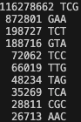
RAAV-30: p005
After barcode extraction
Name Reads (divided by 4) Bc
p005_AAV_01 119853676 117942219 reads (98.41%)
After pairing: Total count of unique sequences: 117941985
Notes:
p007_AAV_03,1387599,115028814 reads (97.88%),NA,NA,NA
p005_AAV_01,1418953,117942219 reads (98.41%),NA,NA,NA
p006_AAV_02,1313473,114166958 reads (97.95%),NA,NA,NA

Slide 31
RAAV-30: p005
After barcode extract
zcat AAV23-01_S1_R1_001_barExt.fastq.gz | wc -l | awk '{print$1/4}’: 117942219
After pairfq
zcat barcodes_5_BarLib_paired_reads.fastq.gz | wc -l | awk '{print$1/4}’ : 117941985
allBCs, Original unique barcodes: 10423435
scBC, SC reduced unique barcodes: 7305463
Notes:
Use the LUT (After filter out barcodes with multiple fragments) -RAAV-60 p005
133094832 multipleContfragmentsComplete.csv
81453542 foundp005_AAV_01.csv
79834 unique_sorted_foundp005_AAV_01.csv by Reads (fragments)

Slide 32
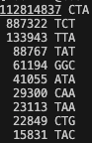
RAAV-30: p006 (p007 template)
After barcode extraction
Name, Reads (divided by 4) Bc
p006_AAV_02 116554762 114166958 reads (97.95%)
After pairing: Total count of unique sequences: 114166682

Slide 33
RAAV-30: p006 (p007 template)
After barcode extract
zcat AAV23-02_S2_R1_001_barExt_7.fastq.gz | wc -l | awk '{print$1/4}’: 114166958
After pairfq
zcat barcodes_6_BarLib_paired_reads.fastq.gz | wc -l | awk '{print$1/4}’: 114166682
allBCs, Original unique barcodes: 9459606
scBC, SC reduced unique barcodes: 7105736
Notes:
Use the LUT (After filter out barcodes with multiple fragments) -RAAV-60 p007
75430580 multipleContfragmentsComplete.csv
23753352 foundp006_AAV_02.csv
125552 unique_sorted_foundp006_AAV_02.csv by Reads (fragments)

Slide 34
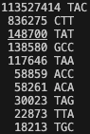
RAAV-30: p007 (p006 template)
After barcode extraction
Name,Reads Reads (divided by 4) Bc
p007_AAV_03, 117518507 115028814 reads (97.88%)
After pairing: Total count of unique sequences: 115028583

Slide 35
RAAV-30: p007 (p006 template)
After barcode extract
zcat AAV23-03_S3_R1_001_barExt_6.fastq.gz | wc -l | awk '{print$1/4}’: 115028814
After pairfq
zcat barcodes_7_BarLib_paired_reads.fastq.gz | wc -l | awk '{print$1/4}’: 115028583
allBCs, Original unique barcodes: 9107539
scBC, SC reduced unique barcodes: 6449445
Notes:
Use the LUT (After filter out barcodes with multiple fragments) -RAAV-60 p006
3082124 multipleContfragmentsComplete.csv
529246 foundp007_AAV_03.csv
After filer with unique fragment : 88853 by Reads (fragments)

Slide 36
Notes:
Barcoded rational AAV vector evolution screening approach. (A) Pie chart displaying the selected 131 proteins with documented affinity to synapses. (B) Schematics of the BRAVE procedure. 1: NCBI reference amino acid sequences were computationally digested into 14-aa (or 22-aa) -long polypeptides with a 1-aa shifting sliding window. 2: Three alternative linkers were added to the 14-aa polypeptides, for example, a rigid linker with 5 alanine residues (14aaA5). 3: Codon-optimized sequences (92,358) were synthesized in parallel on an oligonucleotide array. 4: The pool of oligonucleotides was assembled into an AAV production backbone with cis-acting AAV2 Rep/Cap and ITR-flanking CMV-GFP. A 20-bp random molecular barcode (BC) was simultaneously inserted into the 3′ UTR of the GFP gene. 5a: Using a fraction of the plasmid preparation, exposed to Cre-recombinase in vitro, a look-up table was generated linking the BC to the peptide. 5b: Using the same plasmid pool from step 4, an AAV batch was produced (MNMlib), and multiple parallel screening experiments were performed both in vitro and in vivo followed by BC sequencing from mRNA. 6: Through the combination of the sequenced barcodes and the LUT, transduction efficacy can be mapped back to each of the original 131 proteins, here exemplified by the aa sequence of HSV-1 pUL21. The height of each bar represents the relative abundance of that amino acid, normalized to the total library and summed from all peptides covering the region. 7: Consensus motifs can be determined using the Hammock, hidden Markov model-based clustering approach.

Slide 37
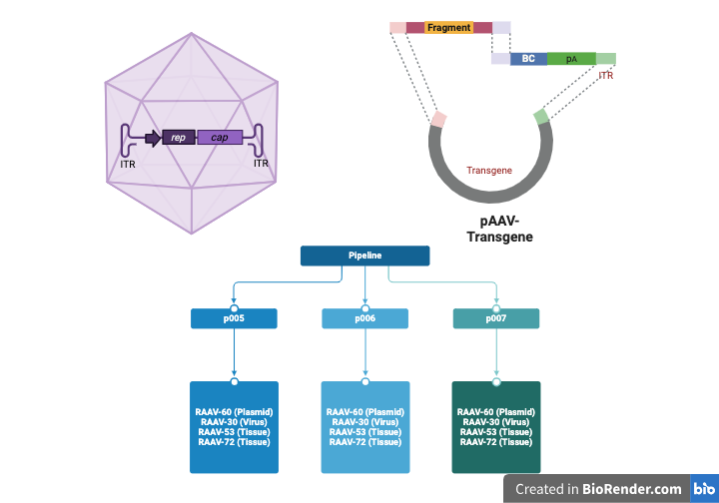
Notes:
https://www.vectorbiolabs.com/intro-to-aav/

